Slide 1
A Real-time Database

Slide 2
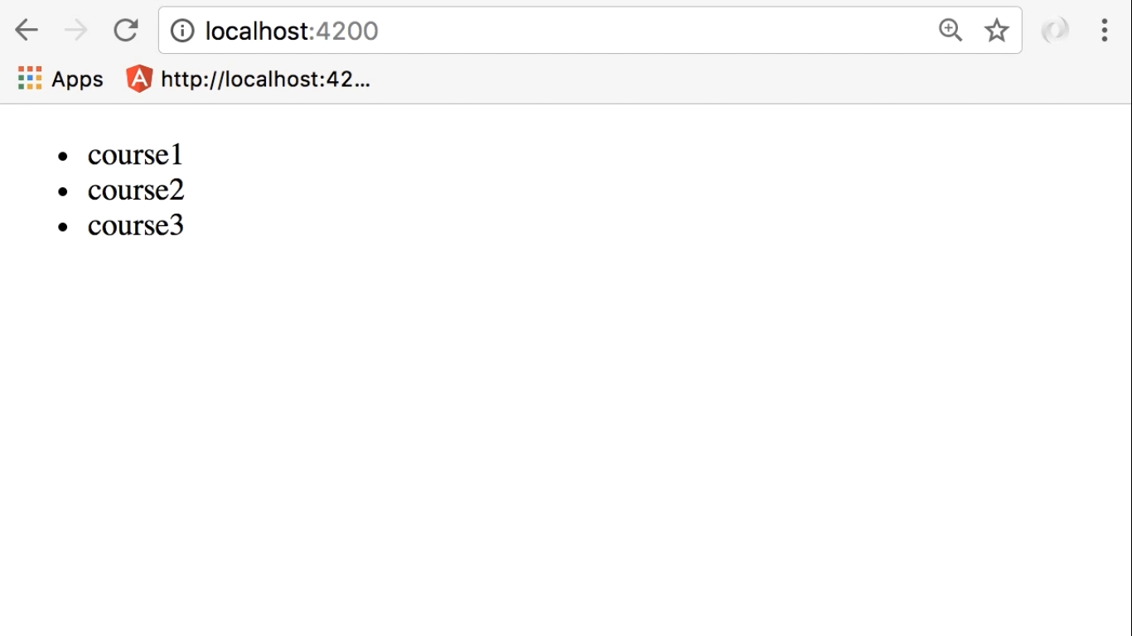

Slide 3
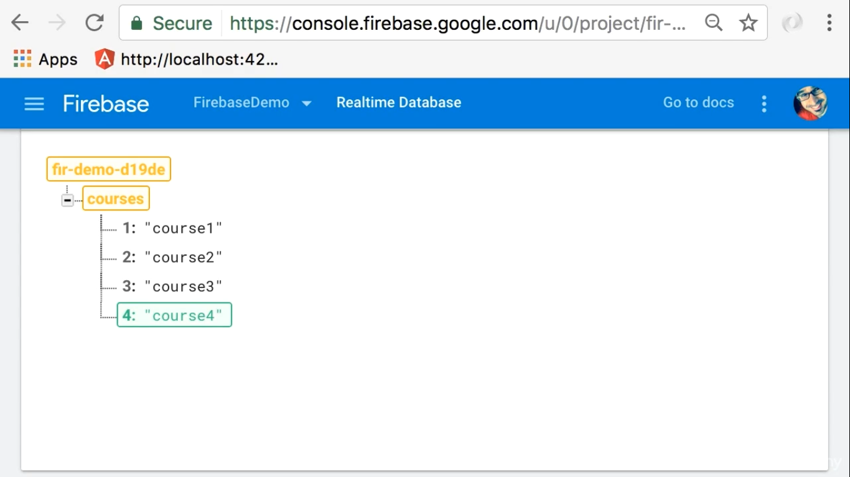

Slide 4
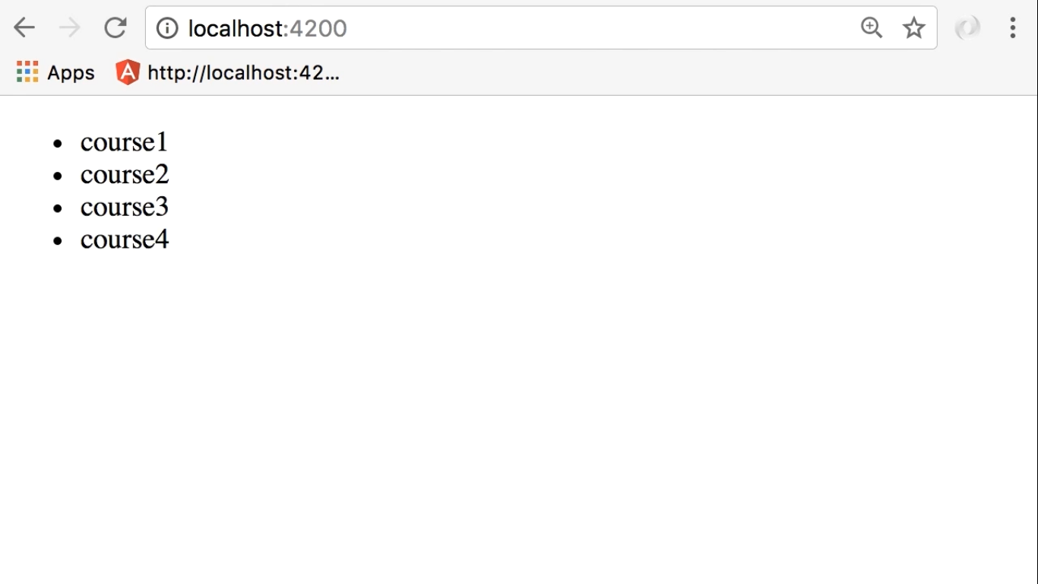
We get course4
Without refreshing the page
This is the beauty of Real-time Database

Slide 5
